Slide 1
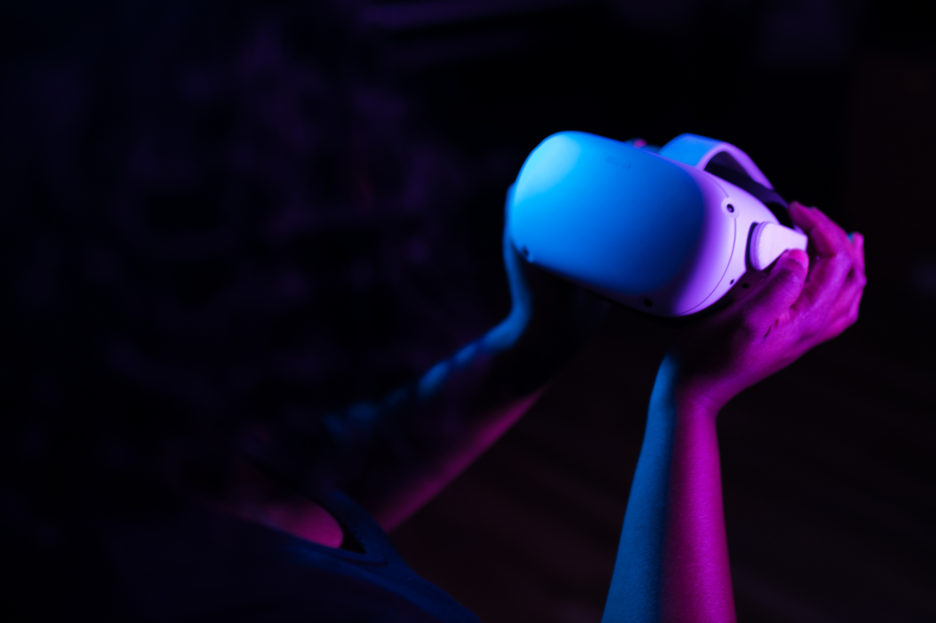
Immersive Technologies: AR and VR
New Era New Technology

Slide 2
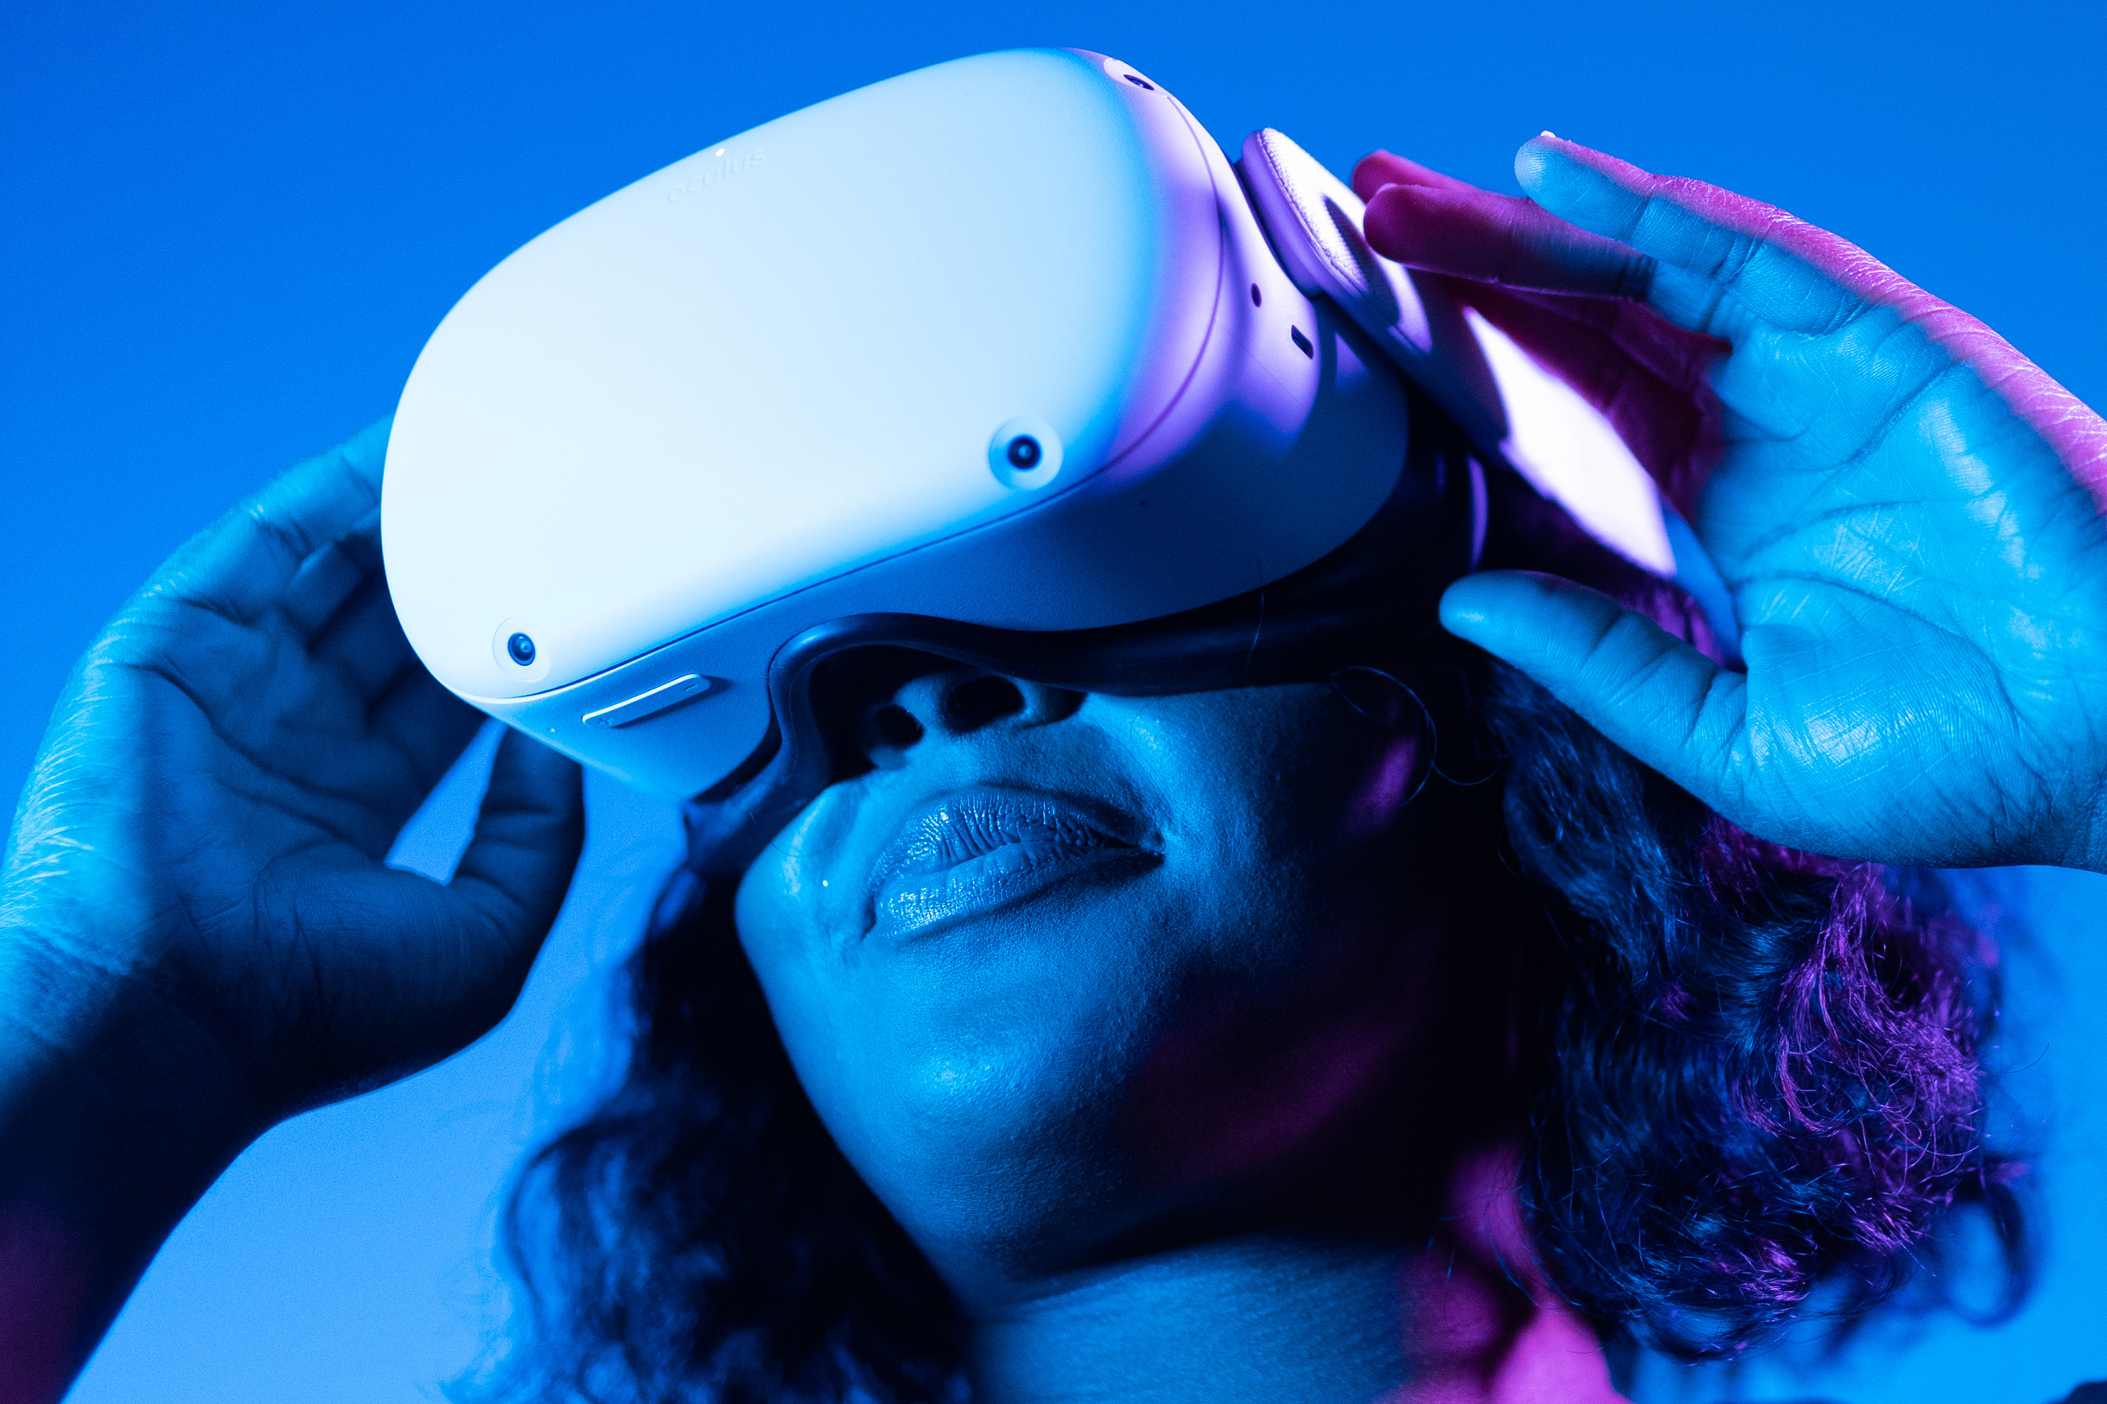
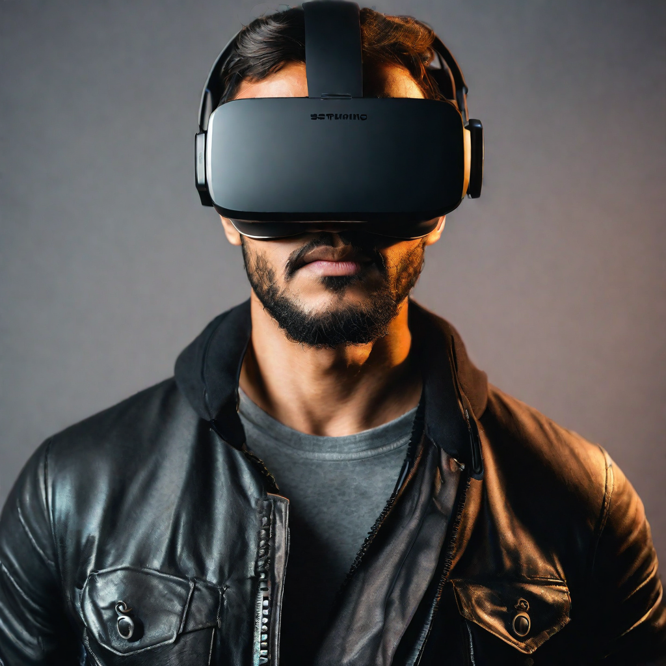
Introduction to AR and VR Technologies :
AR and VR, 21st-century marvels, revolutionize our world. These technologies reshape our reality, offering immersive, once-fictional experiences. This overview delves into their applications, differences, challenges, and future trends. Discover real-world uses, unique VR applications, AR vs. VR distinctions, and the challenges and opportunities on the horizon.

Slide 3
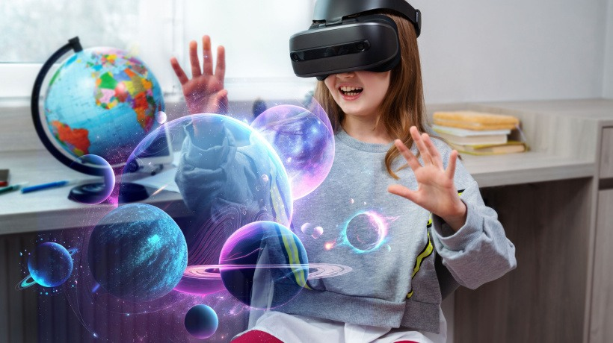

Augmented Reality :
Augmented Reality enhances real-world environments by overlaying computer-generated information, such as images, sounds, or data.
The content can span multiple sensory modalities, including visual, auditory, haptic, somatosensory and olfactory. AR can be defined as a system that incorporates three basic features: a combination of real and virtual worlds, real-time interaction, and accurate 3D registration of virtual and real objects.

Slide 4
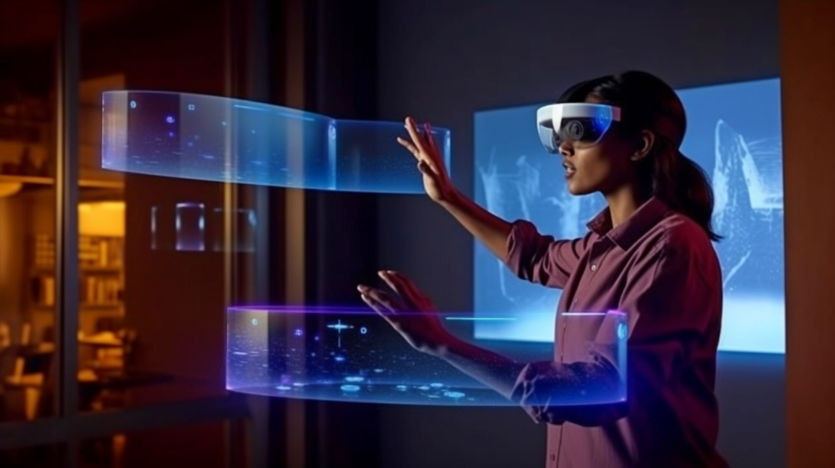
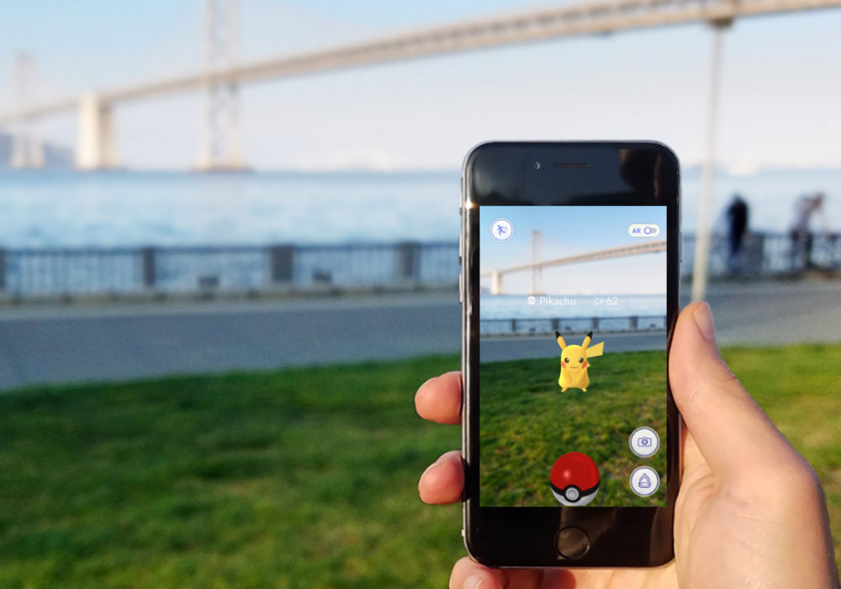
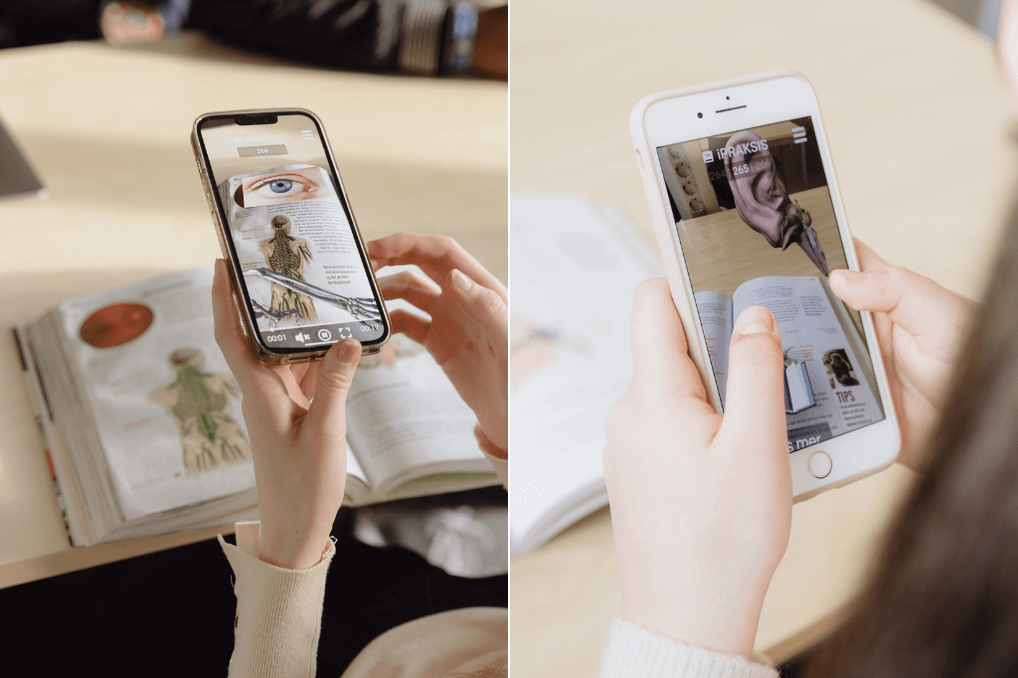
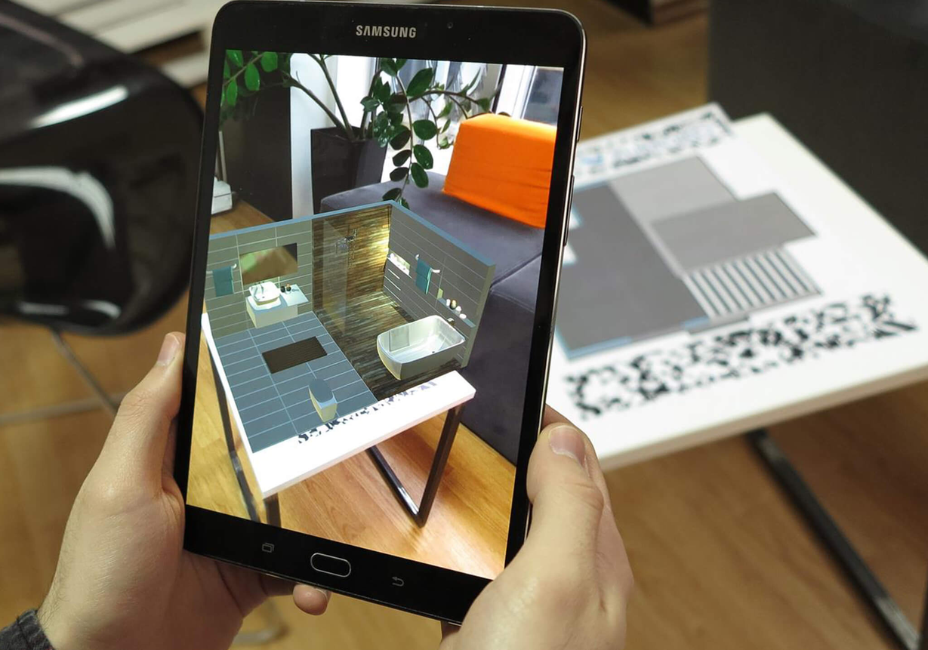
AR Applications :
AR is used in a variety of applications, including gaming, education, and marketing. Examples include:
Pokemon Go :
AR Enabled Text Book :
AR Marketing Campaigns :
AR marketing campaigns that use the technology to create immersive and interactive experiences for customers.
AR-enabled textbooks that allow students to interact with 3D models of objects and concepts.
A popular mobile game that uses AR to superimpose Pokemon characters onto the real world.

Slide 5
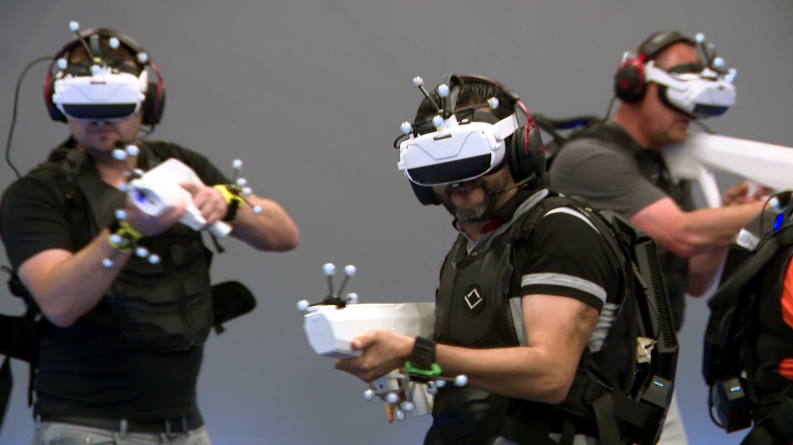
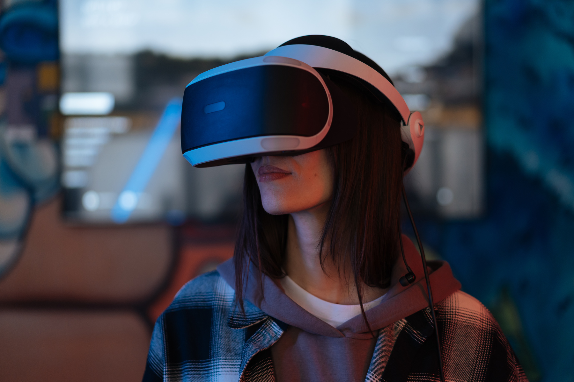
Virtual Reality :
Virtual Reality creates a simulated environment that users can interact with, often using specialized equipment such as VR headsets and controllers.
There are two main types of VR: immersive and non-immersive. Immersive VR fully immerses the user in a virtual environment, while non-immersive VR allows the user to view the virtual environment through a screen or projection.

Slide 6
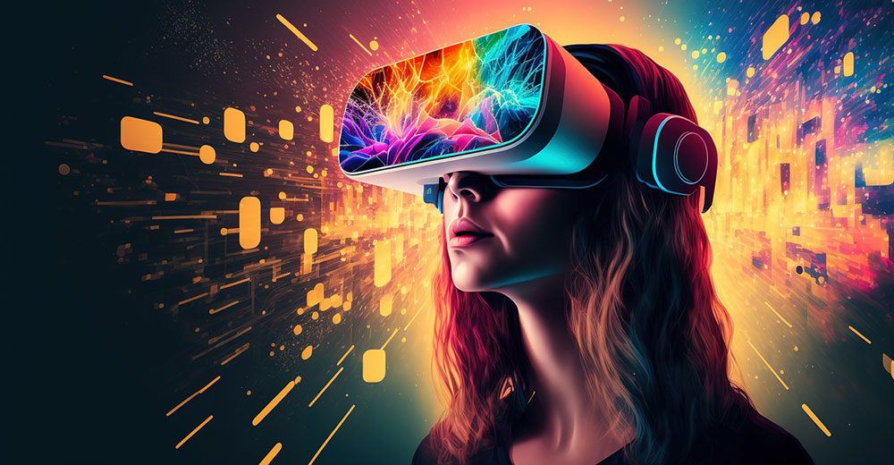
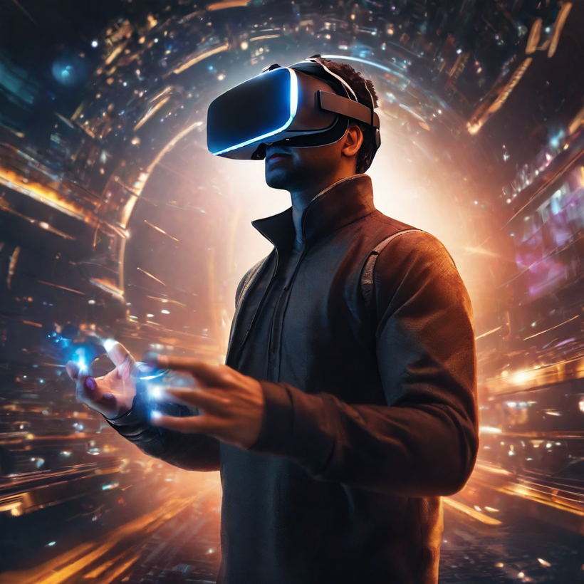

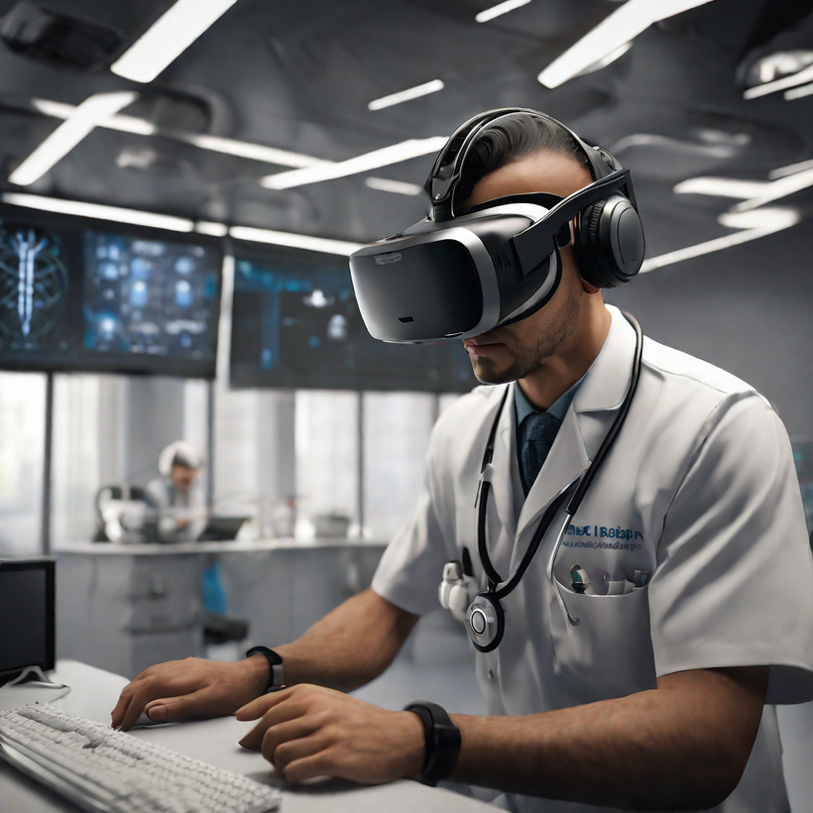
VR Applications :
VR finds applications in gaming, simulations, training, therapy, and virtual tourism, providing users with immersive experiences.
Gaming :
Training and Simulation :
Virtual Tourism :
VR gaming epitomizes virtual reality's allure, enabling full immersion in a 3D world and unprecedented interactive experiences.
VR tech trains professionals across fields, offering realistic simulations for hands-on experiences in medicine, construction, and more.
VR tech enables virtual tourism, revolutionizing travel by allowing users to explore exotic locations from home.

Slide 7
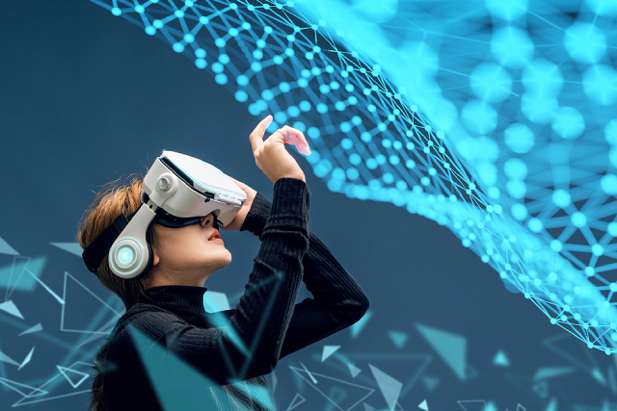
Augmented Reality Vs Virtual Reality :
Aspect | Augmented Reality (AR) | Virtual Reality (VR)
Interaction | Overlays digital content on real-world environment | Creates fully immersive artificial environment
User Experience | Simultaneously experiences real and digital elements | Fully immersed with limited awareness of reality
Hardware | Uses devices like smartphones, tablets, or AR glasses | Requires specialized VR headsets and controllers
Use Cases | Applied in navigation, gaming, education, training | Primarily used for gaming, simulations, and training
Immersiveness | Enhances real world without fully replacing it | Offers high immersion by replacing surroundings

Slide 8
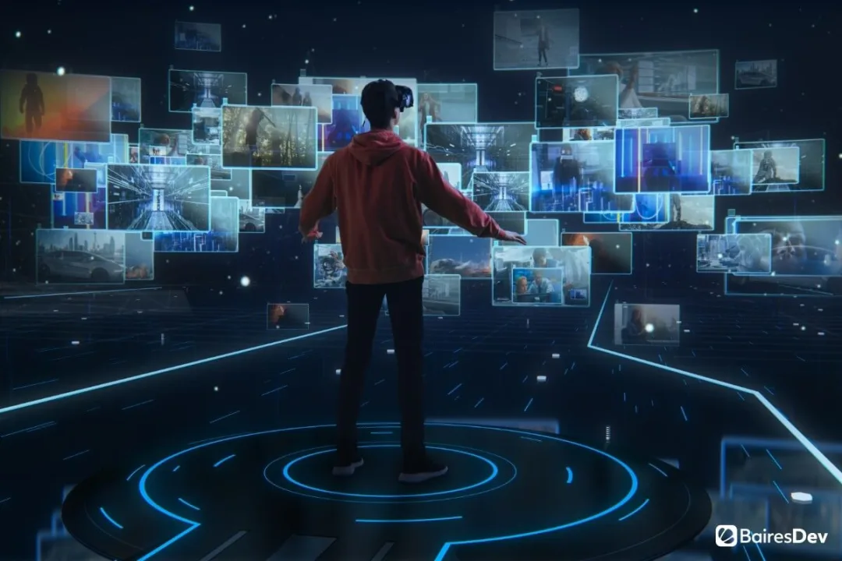
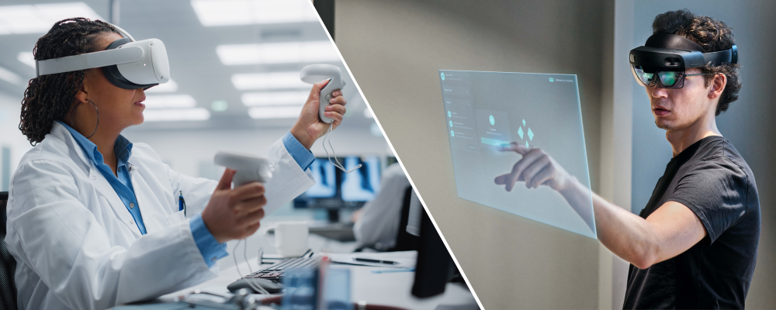
Conclusion :
In conclusion, AR enhances reality with overlays, VR immerses users in a virtual world. Both evolving technologies face challenges, but advancing hardware and software promise innovative uses, hinting at broader adoption in our daily lives.

